Slide 1
Chapter 6
Circular Motion and Other Applications of Newton’s Laws

Slide 2
Newton’s Second Law for a Particle in Uniform Circular Motion
Two analysis models using Newton’s Laws of Motion have been developed.
The models have been applied to linear motion.
Newton’s Laws can be applied to other situations:
Objects traveling in circular paths
Motion observed from an accelerating frame of reference
Motion of an object through a viscous medium
Many examples will be used to illustrate the application of Newton’s Laws to a variety of new circumstances.
Introduction

Slide 3
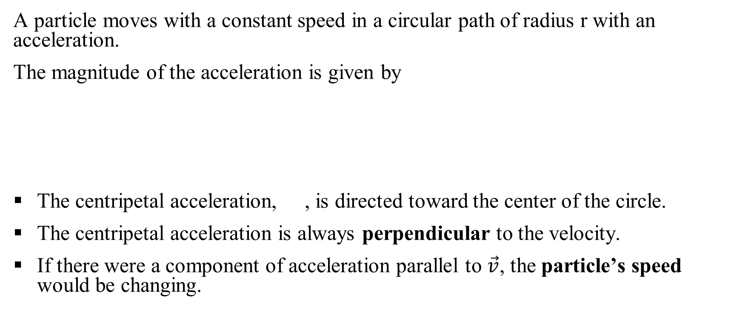
Uniform Circular Motion, Acceleration
A particle moves with a constant speed in a circular path of radius r with an acceleration.
The magnitude of the acceleration is given by
The centripetal acceleration, , is directed toward the center of the circle.
The centripetal acceleration is always perpendicular to the velocity.
If there were a component of acceleration parallel to $\vec{v}$, the particle’s speed would be changing.
Section 6.1

Slide 4
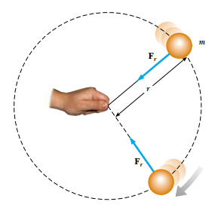
Uniform Circular Motion, Force
A force, , is associated with the centripetal acceleration.
The force is also directed toward the center of the circle.
Applying Newton’s Second Law along the radial direction gives
Section 6.1

Slide 5
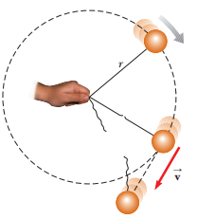
Uniform Circular Motion, cont.
A force causing a centripetal acceleration acts toward the center of the circle.
It causes a change in the direction of the velocity vector.
If the force vanishes, the object would move in a straight-line path tangent to the circle.
Section 6.1

Slide 6
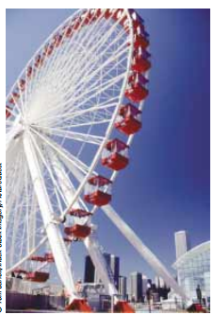
Quick Quiz 6.1
________________________________________________________
You are riding on a Ferris wheel that is rotating with constant speed. The car in which you are riding always maintains its correct upward orientation; it does not invert. (i)What is the direction of the normal force on you from the seat when you are at the top of the wheel? (a) upward (b) downward (c) impossible to determine
(ii) From the same choices, what is the direction of the net force on you when you are at the top of the wheel?

Slide 7
What provides Centripetal Force ?
Centripetal force is not a new kind of force
Centripetal force refers to any force that keeps an object following a circular path
Centripetal force is a combination of
Gravitational force mg: downward to the ground
Normal force N: perpendicular to the surface
Tension force T: along the cord and away from object
Static friction force: f_{smax} = µ_{s}N

Slide 8
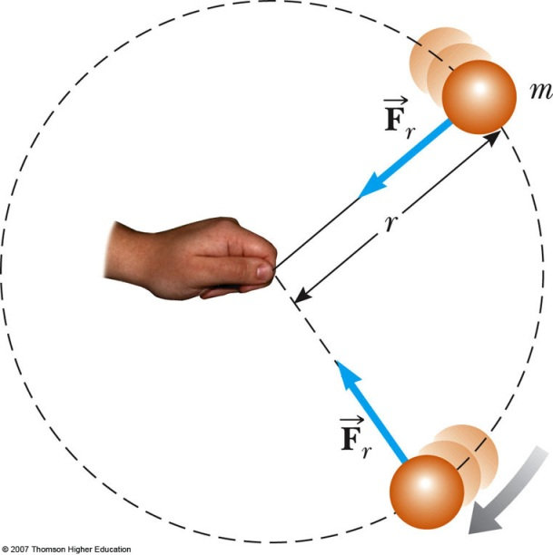
What provides Centripetal Force ?
N
a
v
mg

Slide 9
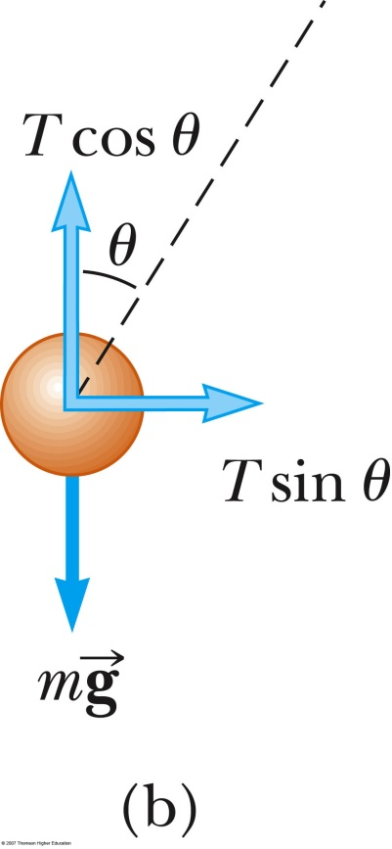
The Conical Pendulum
A small ball of mass m = 5 kg is suspended from a string of length L = 5 m. The ball revolves with constant speed v in a horizontal circle of radius r = 2 m. Find an expression for v and a.
T
θ
mg

Slide 10
The Conical Pendulum
Find v and a

Slide 11
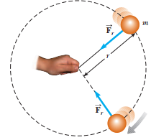
Problem 6.2:
A ball of mass 0.500 kg is attached to the end of a cord 1.50 m long. The ball is whirled in a horizontal circle as shown in Figure 6.1. If the cord can withstand a maximum tension of 50.0 N, what is the maximum speed at which the ball can be whirled before the cord breaks? Assume the string remains horizontal during the motion.
Solution: Applying Newton’s second law
For maximum speed
Fig:6.1

Slide 12
Problem
A ball of mass 0.500 kg is attached to the end of a cord 1.50 m long. The ball is whirled in a horizontal circle as shown in Figure. If the cord can withstand a maximum tension of 50.0 N, what is the maximum speed at which the ball can be whirled before the cord breaks? Assume that the string remains horizontal during the motion.
What If? Suppose that the ball is whirled in a circle of larger radius at the same speed v. Is the cord more likely to break or less likely?

Slide 13
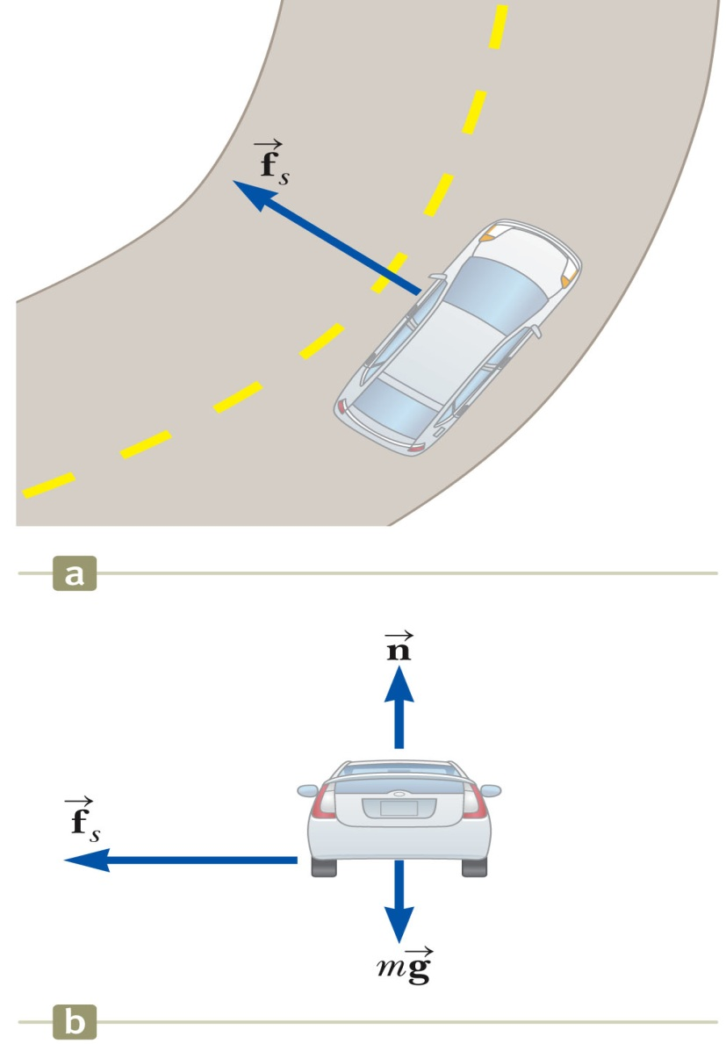
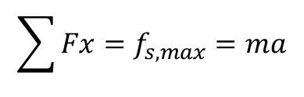
Horizontal (Flat) Curve
A 1500-kg car moving on a flat, horizontal road negotiates a curve as shown in Figure 6.4a. If the radius of the curve is 35.0 m and the coefficient of static friction between the tires and dry pavement is 0.523, find the maximum speed the car can have and still make the turn successfully Solution:
Section 6.1

Slide 14
Conclusion: Horizontal (Flat) Curve
Note that the maximum speed does not depend on the mass of the car. That is why curved highways do not need multiple speed limit signs to cover the various masses of vehicles using the road

Slide 15
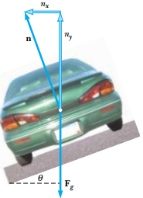
Problem:6.2 The Banked Roadway
A civil engineer wishes to design a curved exit ramp for a highway in such a way that a car will not have to rely on friction to round the curve without skidding. In other words, a car moving at the designated speed can negotiate the curve even when the road is covered with ice. Such a ramp is usually banked; this means the roadway is tilted toward the inside of the curve. Suppose the designated speed for the ramp is to be 13.4 m/s (30.0 mi/h) and the radius of the curve is 50.0 m.
At what angle should the curve be banked?

Slide 16
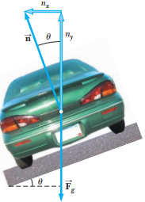

Solution:
Applying Newton’s second law
Divide Equation (1) by Equation (2):
What If? Imagine that this same roadway were built on Mars in the future to connect different colony centers. Could it be traveled at the same speed?

Slide 17
Banked Curve, 2
The banking angle is independent of the mass of the vehicle.
If the car rounds the curve at less than the design speed, friction is necessary to keep it from sliding down the bank.
If the car rounds the curve at more than the design speed, friction is necessary to keep it from sliding up the bank.
Section 6.1

Slide 18
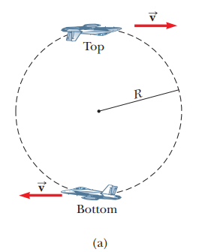
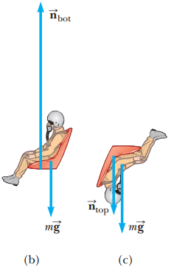
Problem 6.5: Let’s Go Loop-the-Loop!
A pilot of mass m in a jet aircraft executes a loop-the- loop, as shown in Figure. In this maneuver, the aircraft moves in a vertical circle of radius 2.70 km at a constant speed of 225 m/s. (A) Determine the force exerted by the seat on the pilot at the bottom of the loop. Express your answer in terms of the weight of the pilot mg
Solution: At the bottom of loop

Slide 19
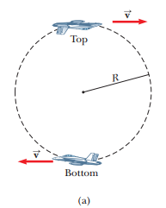
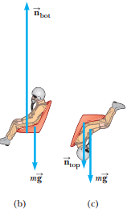
Problem 6.5: Let’s Go Loop-the-Loop!
(B) Determine the force exerted by the seat on the pilot at the top of the loop.
Solution: At the top of the loop

Slide 20
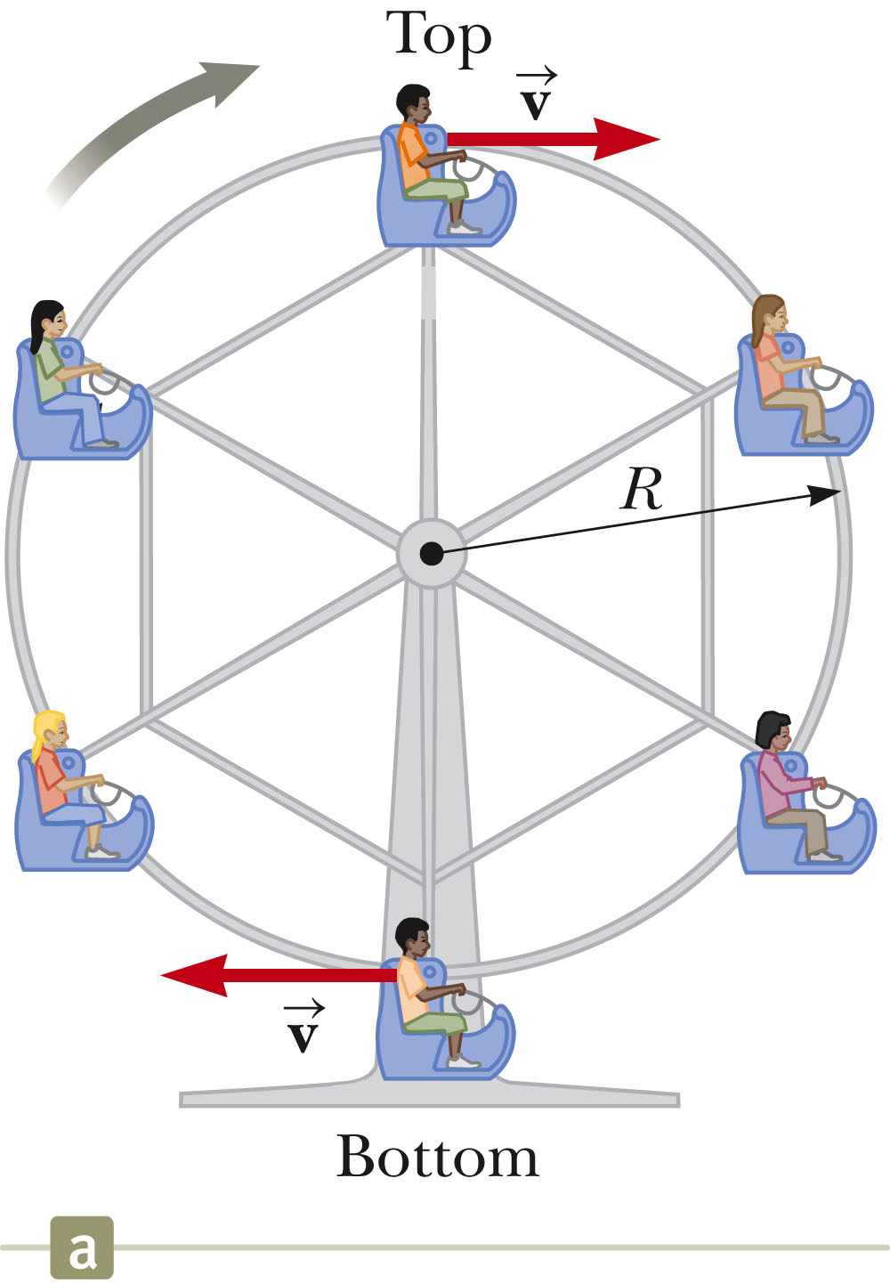
Ferris Wheel
The normal and gravitational forces act in opposite direction at the top and bottom of the path.
Section 6.1

Slide 21
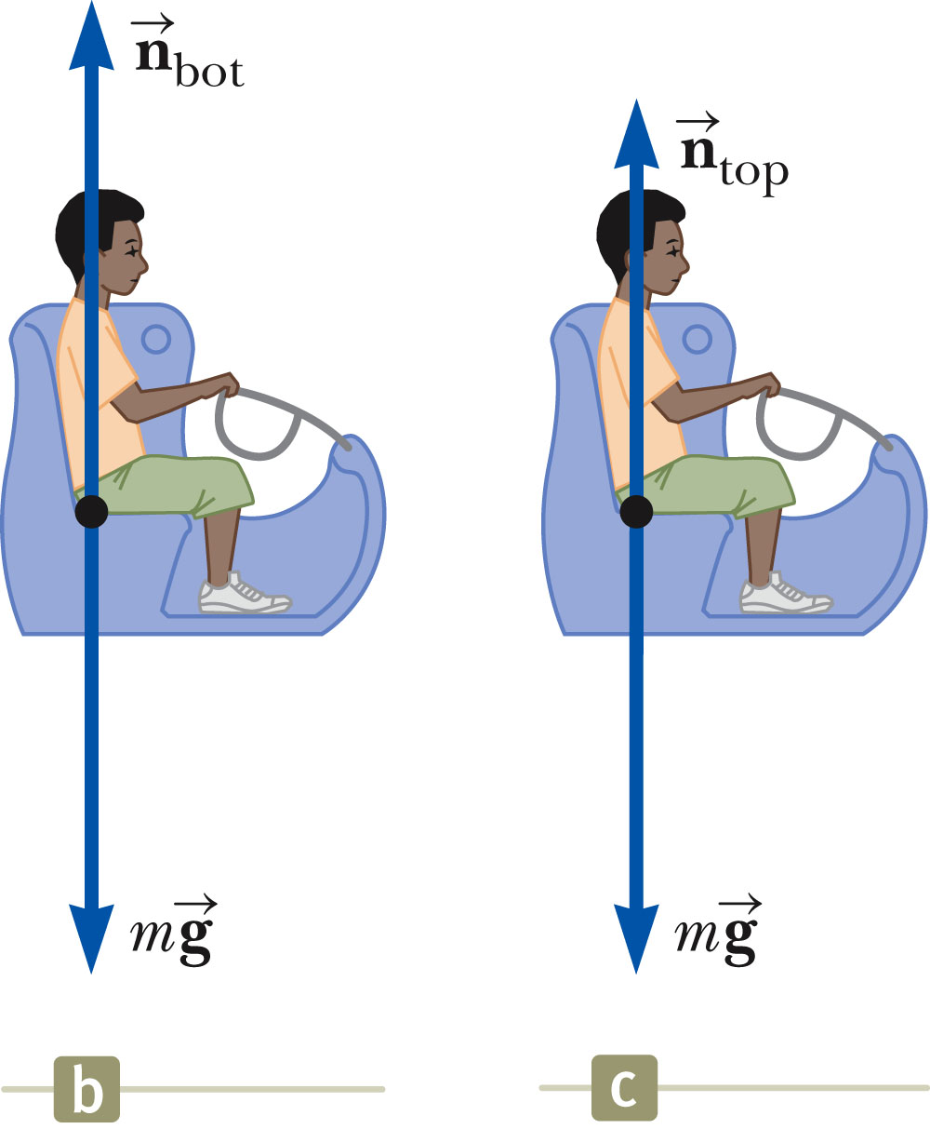
Ferris Wheel, cont.
At the bottom of the loop, the upward force (the normal) experienced by the object is greater than its weight.
Section 6.1

Slide 22
Ferris Wheel, final
At the top of the circle, the force exerted on the object is less than its weight.
Section 6.1

Slide 23
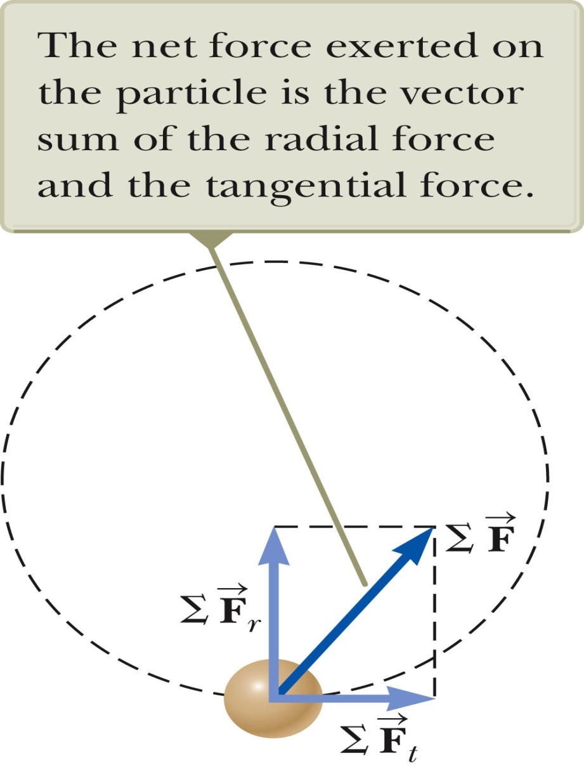
Non-Uniform Circular Motion
if a particle moves with varying speed in a circular path there is, in addition to the radial component of acceleration, a tangential component having magnitude dv/dt.
Because
The acceleration and force have tangential components.
produces the centripetal acceleration
produces the tangential acceleration
The total force is
Section 6.2

Slide 24
6.3:
Quick Quiz: Which of the following is impossible for a car moving in a circular path?
The car has tangential acceleration but no centripetal acceleration.
The car has centripetal acceleration but no tangential acceleration.
The car has both centripetal acceleration and tangential acceleration.

Slide 25
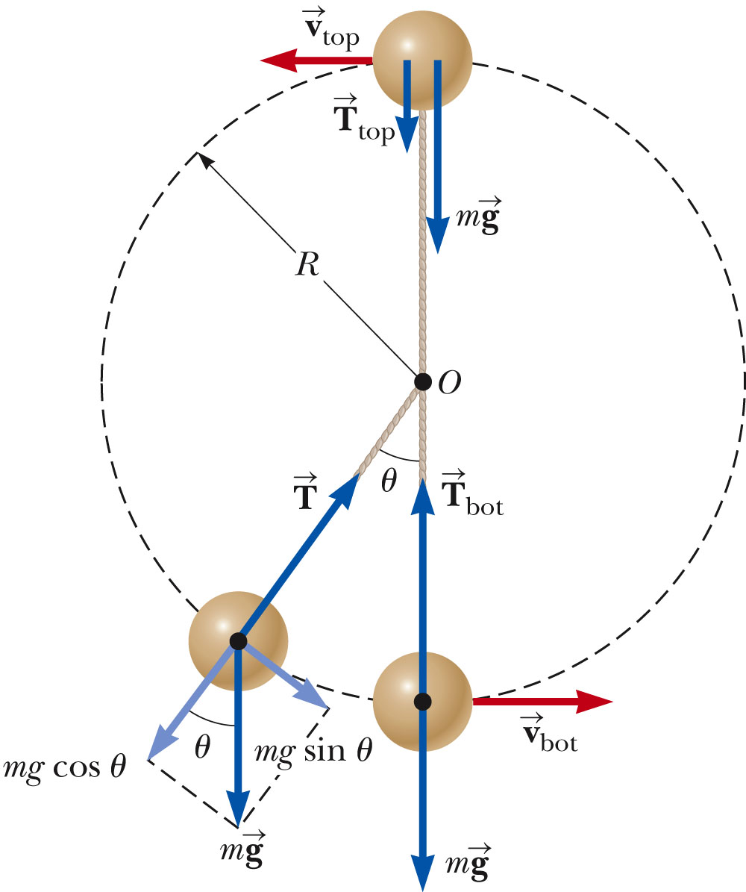
Problem 6.6: Vertical Circle with Non-Uniform Speed
A small sphere of mass m is attached to the end of a cord of length R and set into motion in a vertical circle about a fixed point O as illustrated in Figure.
Determine the tension in the cord at any instant when the speed of the sphere is v and the cord makes an angle θ with the vertical
Section 6.2

Slide 26

Top and Bottom of Circle
The tension at the bottom is a maximum.
The tension at the top is a minimum.
If T_{top} = 0, then
Section 6.2

Slide 27
FICTITIOUS FORCES AND NON-INERTIAL FRAMES:
What do taking off in a jet airplane, turning a corner in a car, riding a merry-go-roun?
Each exhibits fictitious forces—unreal forces that arise from motion and may seem real, because the observer’s frame of reference is accelerating or rotating.

Slide 28
Motion in Accelerated Frames
A fictitious force (non-real force) results from an accelerated frame of reference.
The fictitious force is due to observations made in an accelerated frame.
A fictitious force appears to act on an object in the same way as a real force, but you cannot identify a second object for the fictitious force.
Remember that real forces are always interactions between two objects.
Simple fictitious forces appear to act in the direction opposite that of the acceleration of the non-inertial frame.
Section 6.3

Slide 29
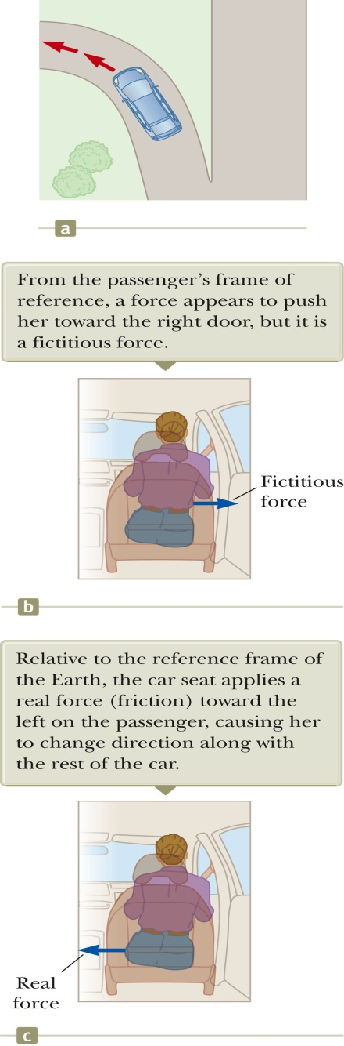
“Centrifugal” Force
From the frame of the passenger (b), a force appears to push him toward the door.
From the frame of the Earth, the car applies a leftward force on the passenger.
The outward force is often called a centrifugal force.
It is a fictitious force due to the centripetal acceleration associated with the car’s change in direction.
In actuality, friction supplies the force to allow the passenger to move with the car.
If the frictional force is not large enough, the passenger continues on her initial path according to Newton’s First Law.
Section 6.3

Slide 30
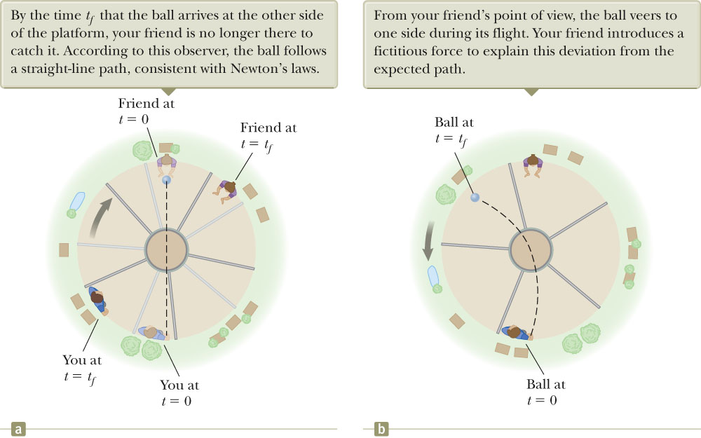
“Coriolis Force”
This is an apparent force caused by changing the radial position of an object in a rotating coordinate system.
The result of the rotation is the curved path of the thrown ball.
From the catcher’s point of view, a sideways force caused the ball to follow a curved path.
Section 6.3

Slide 31
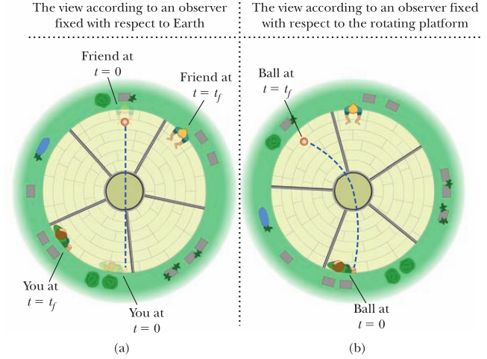
“Coriolis Force”

Slide 32
Fictitious Forces, examples
Although fictitious forces are not real forces, they can have real effects.
Examples:
Objects in the car do slide
You feel pushed to the outside of a rotating platform
The Coriolis force is responsible for the rotation of weather systems, including hurricanes, and ocean currents.
Section 6.3

Slide 33
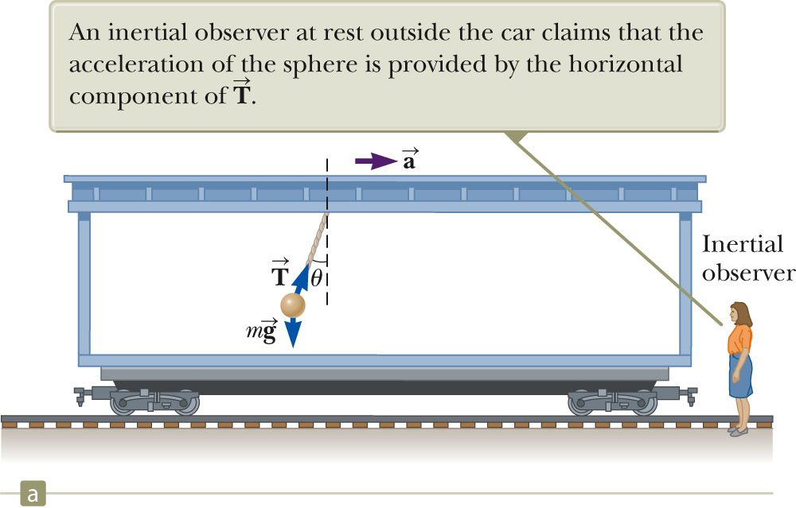
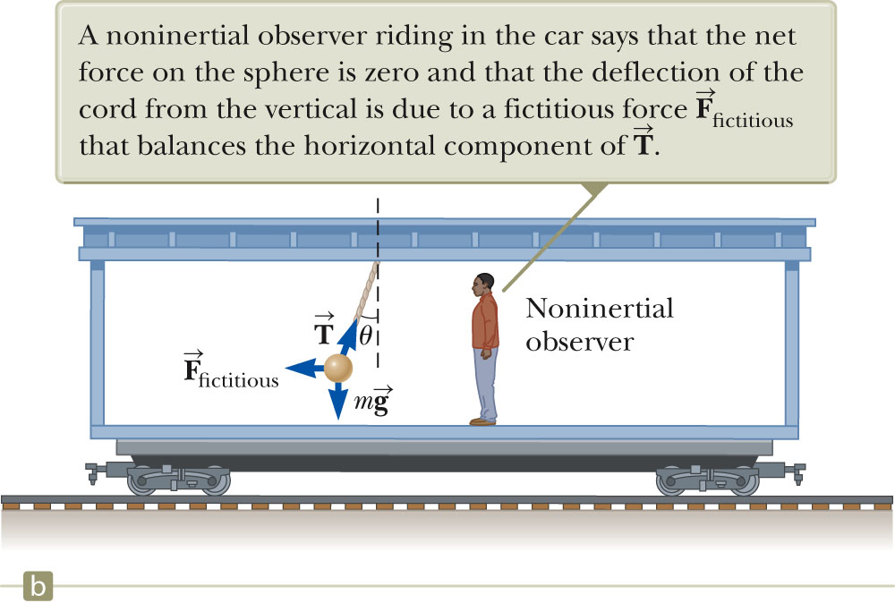
Problem 6.7: Fictitious Forces in Linear Systems
A small sphere of mass m hangs by a cord from the ceiling of a boxcar that is accelerating to the right as shown in Figure 6.12.
The non-inertial observer in Figure 6.12b claims that a force, which we know to be fictitious, causes the observed deviation of the cord from the vertical.
How is the magnitude of this force related to the boxcar’s acceleration measured by the inertial observer in Figure 6.12a?
Section 6.3

Slide 34
Solution: 6.7
The inertial observer (a) at rest sees
The non-inertial observer (b) sees
These are equivalent if F_{fictiitous}= ma, where a is the acceleration according to the inertial observer.
Section 6.3

Slide 35
What If? Suppose the inertial observer wants to measure the acceleration of the train by means of the pendulum (the sphere hanging from the cord). How could he do so?
Answer: a = g tanθ

Slide 36
Motion with Resistive Forces
Motion can be through a medium.
Either a liquid or a gas
The medium exerts a resistive force, , on an object moving through the medium.
The magnitude of depends on the medium.
The direction of is opposite the direction of motion of the object relative to the medium.
nearly always increases with increasing speed.
Section 6.4

Slide 37
Motion with Resistive Forces, cont.
The magnitude of can depend on the speed in complex ways.
We will discuss only two:
is proportional to v
Good approximation for slow motions or small objects
is proportional to v²
Good approximation for large objects
Section 6.4

Slide 38
Model 1:Resistive Force Proportional To Speed
The resistive force can be expressed as
b depends on the property of the medium, and on the shape and dimensions of the object.
The negative sign indicates is in the opposite direction to .
Section 6.4

Slide 39
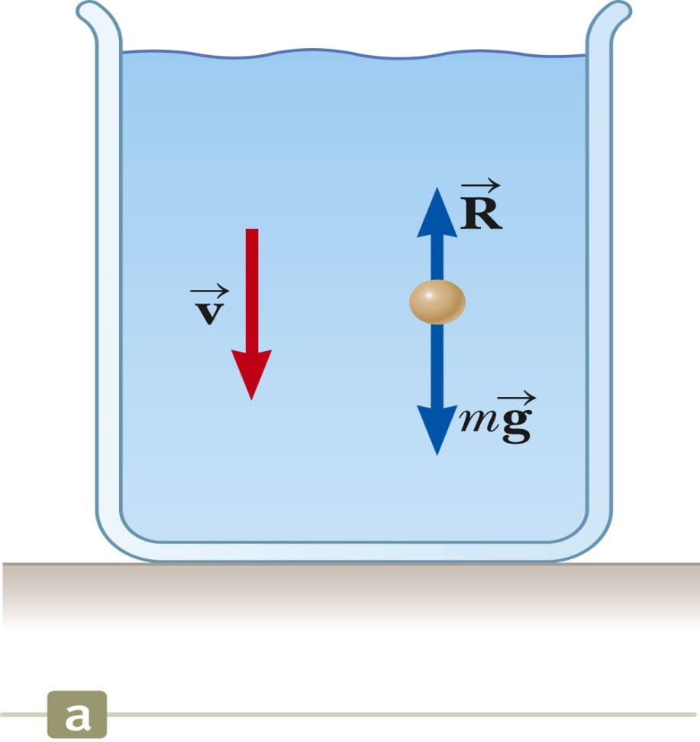
Resistive Force Proportional To Speed, Example
Assume a small sphere of mass m is released from rest in a liquid.
Forces acting on it are:
Resistive force
Gravitational force
Analyzing the motion results in
Section 6.4

Slide 40
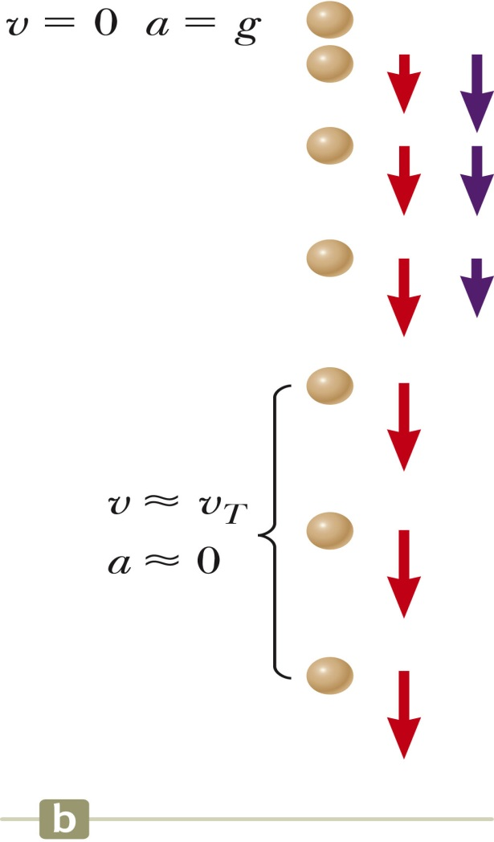
Resistive Force Proportional To Speed, Example, cont.
Initially, v = 0 and dv/dt = g
As t increases, R increases and a decreases
The acceleration approaches 0 when R = mg
At this point, v approaches the terminal speed of the object.

Slide 41
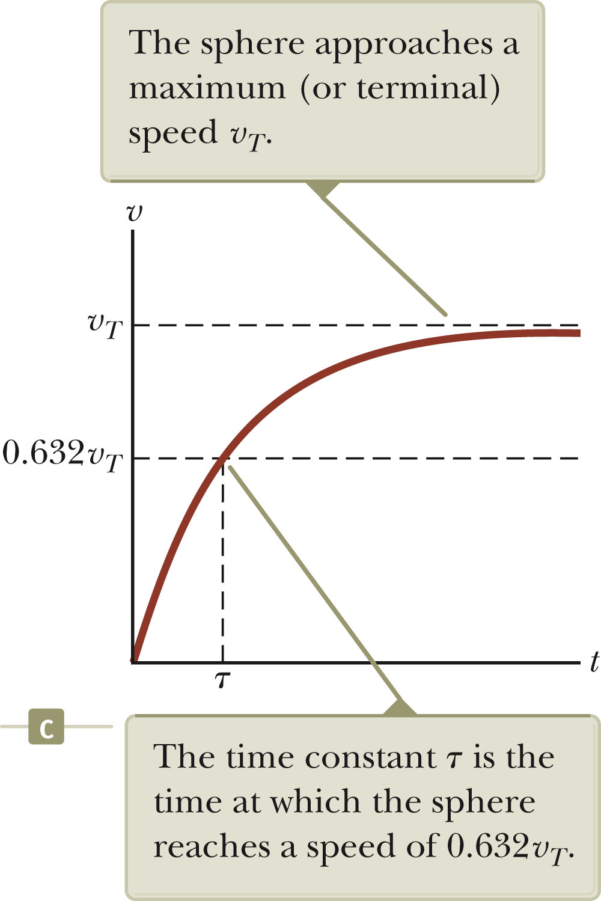
Terminal Speed
To find the terminal speed, let a = 0
Solving the differential equation gives
t is the time constant and
τ = m/b
Section 6.4

Slide 42
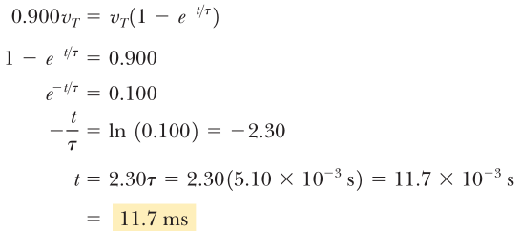
Problem: 6.8
A small sphere of mass 2.00 g is released from rest in a large vessel filled with oil, where it experiences a resistive force proportional to its speed. The sphere reaches a terminal speed of 5.00 cm/s.
Determine the time constant t and the time at which the sphere reaches 90.0% of its terminal speed.
Solution: As

Slide 43
Resistive Force Proportional To v²
For objects moving at high speeds through air, such as airplanes, skydivers, cars, and baseballs, the resistive force is approximately equal to the square of the speed.
R = ½ DrAv²
D is a dimensionless empirical quantity called the drag coefficient.
r is the density of air.
A is the cross-sectional area of the object.
v is the speed of the object.
Section 6.4

Slide 44
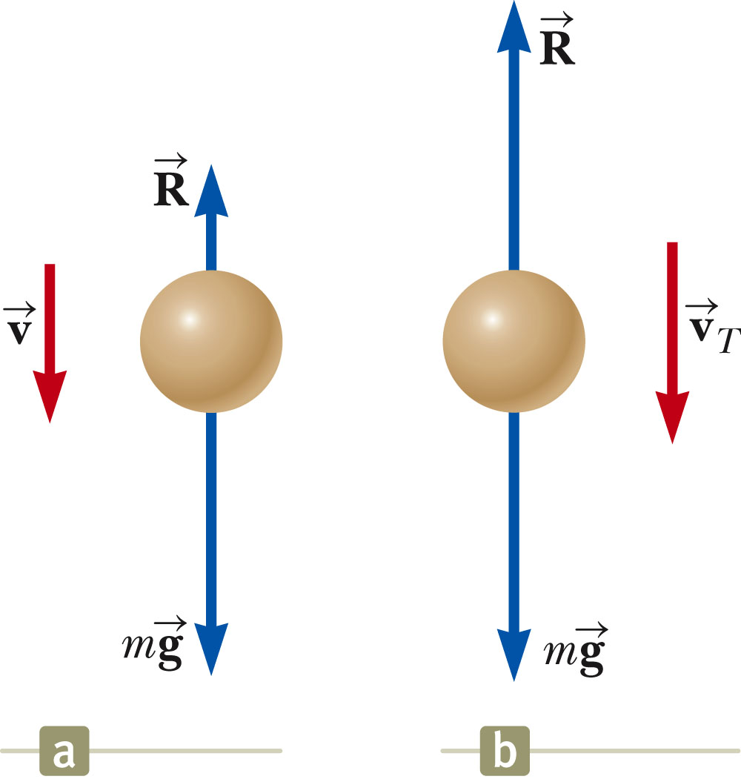
Resistive Force Proportional To v², example
For instance, analysis of an object falling through air accounting for air resistance.
Section 6.4

Slide 45
Resistive Force Proportional To v², Terminal Speed
The terminal speed will occur when the acceleration goes to zero.
Solving the previous equation gives
Setting a= 0
Section 6.4

Slide 46
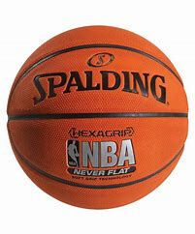

Quick Quiz 6.4
A baseball and a basketball, having the same mass, are dropped through air from rest such that their bottoms are initially at the same height above the ground, on the order of 1 m or more. Which one strikes the ground first?
(a) The baseball strikes the ground first.
(b) The basketball strikes the ground first.
(c) Both strike the ground at the same time.
Basket ball
Base ball

Slide 47
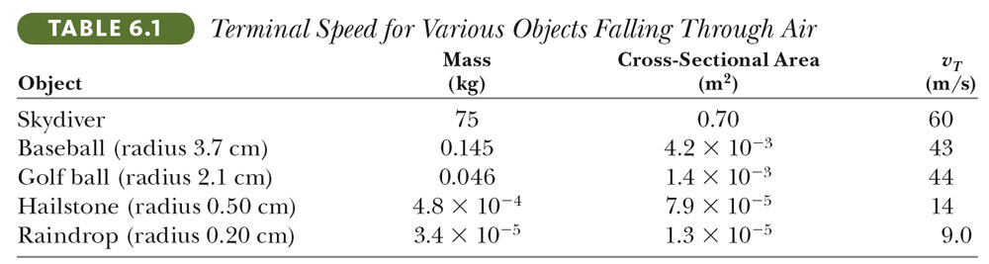
Some Terminal Speeds
Section 6.4

Slide 48
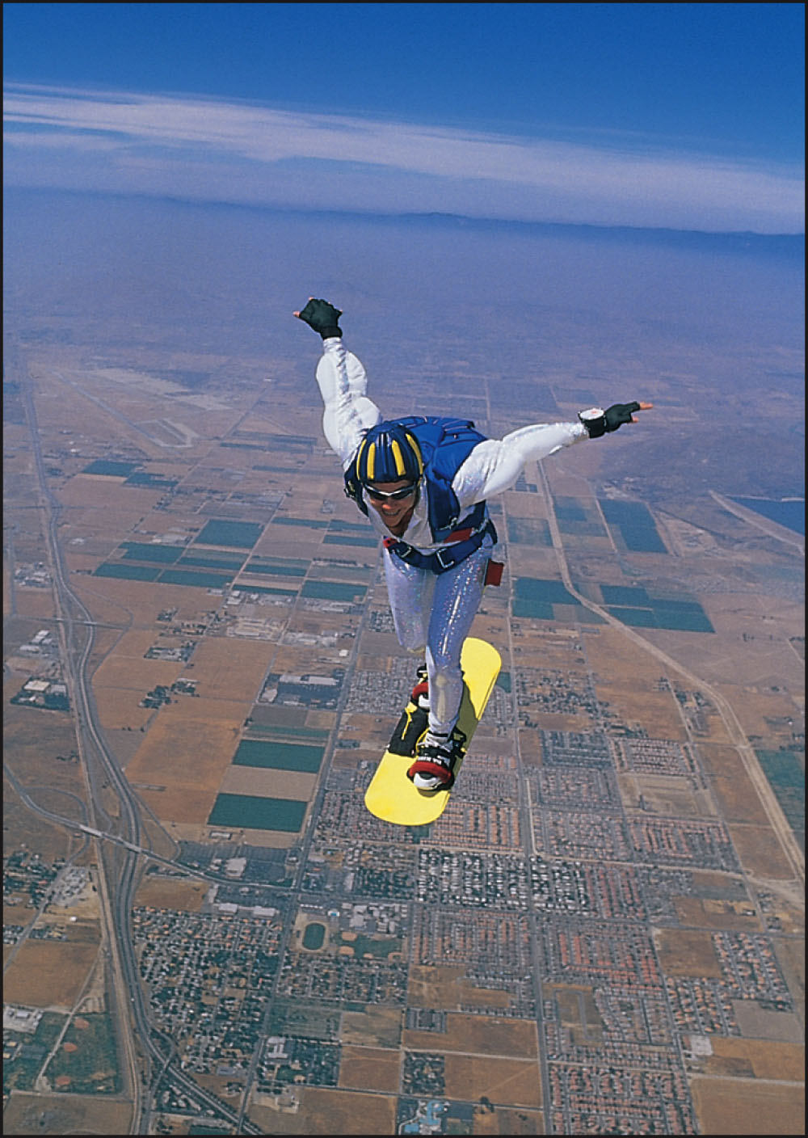
Example: Skysurfer
Consider a skysurfer (Fig. 6.15) who jumps from a plane with her feet attached firmly to her surfboard, does some tricks, and then opens her parachute. Describe the forces acting on her during these maneuvers.
Section 6.4

Slide 49
Example: Skysurfer
Step from plane
Initial velocity is 0
Gravity causes downward acceleration
Downward speed increases, but so does upward resistive force
Eventually, downward force of gravity equals upward resistive force
Traveling at terminal speed
Section 6.4

Slide 50
Skysurfer, cont.
Open parachute
Some time after reaching terminal speed, the parachute is opened.
Produces a drastic increase in the upward resistive force
Net force, and acceleration, are now upward
The downward velocity decreases.
Eventually a new, smaller, terminal speed is reached.
Section 6.4

Slide 51
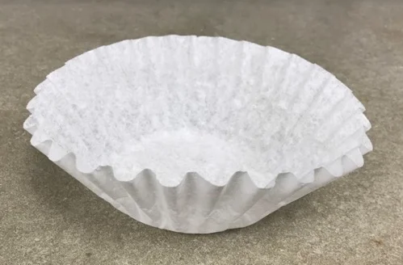
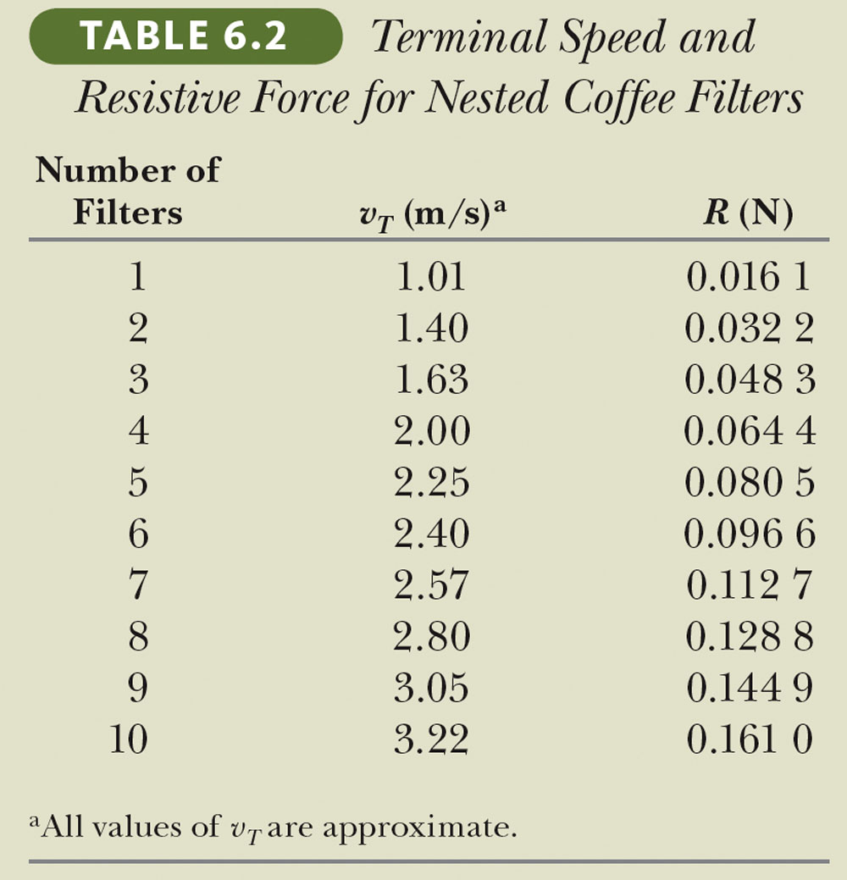
Example: Coffee Filters
The dependence of resistive force on the square of the speed is a model. Let’s test the model for a specific situation. Imagine an experiment in which we drop a series of stacked coffee filters and measure their terminal speeds. Table 6.2 presents typical terminal speed data from a real experiment using these coffee filters as they fall through the air. The time constant t is small, so a dropped filter quickly reaches terminal speed. Each filter has a mass of 1.64 g. When the filters are nested together, they stack in such a way that the front-facing surface area does not increase.
Determine the relationship between the resistive force exerted by the air and the speed of the falling filters.
Section 6.4

Slide 52
Coffee Filters, cont.
Data obtained from experiment:
At the terminal speed, the upward resistive force balances the downward gravitational force.
R = mg
Section 6.4

Slide 53
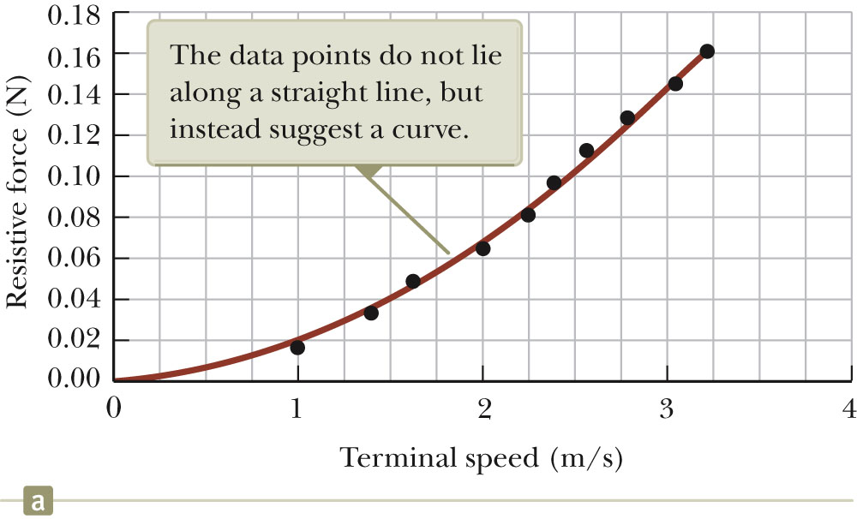
Coffee Filters, Graphical Analysis
Graph of resistive force and terminal speed does not produce a straight line.
The resistive force is not proportional to the object’s speed.
Section 6.4

Slide 54
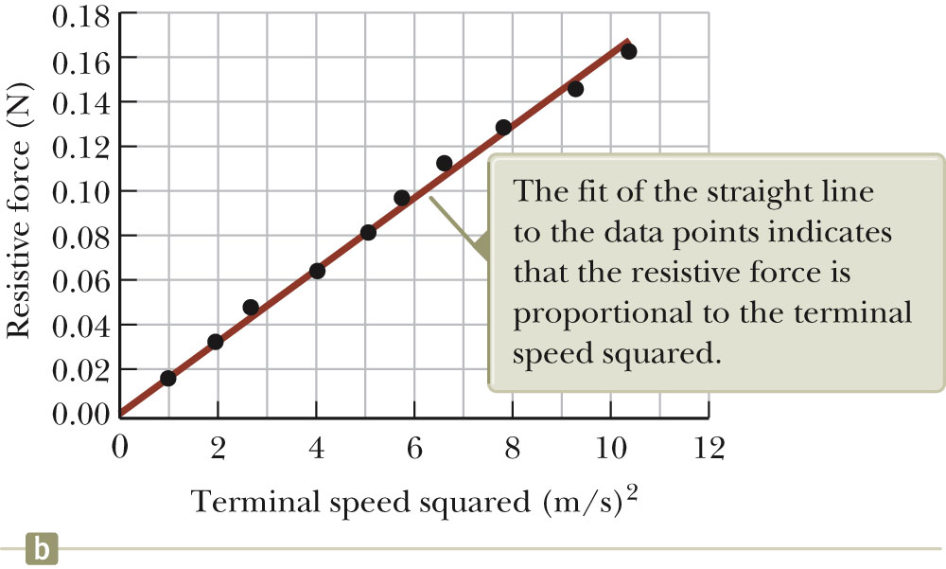
Coffee Filters, Graphical Analysis 2
Graph of resistive force and terminal speed squared does produce a straight line.
The resistive force is proportional to the square of the object’s speed.
Section 6.4

Slide 55
Problem 6.11: Resistive Force on a Baseball
A pitcher hurls a 0.145-kg baseball past a batter at 40.2 m/s ( 90 mi/h).
Find the resistive force acting on the ball at this speed.
Solution:
Section 6.4

Slide 56
Resistive Force on a Baseball – Example
The object is moving horizontally through the air.
The resistive force causes the ball to slow down.
Gravity causes its trajectory to curve downward.
The ball can be modeled as a particle under a net force.
Consider one instant of time, so not concerned about the acceleration
Analyze to find D and R
Section 6.4

